Slide 1

Loan Status Prediction model A Machine Learning PROJECT
Alok Ranjan – (2K22/SE/15)
Farhan Jafar – (2K22/SE/63)
Batch – A1
Subject Code – SE 204

Slide 2
Outline of project
Project Rationale
Introduction
Dataset
Results
Limitations
Conclusion
Refrences

Slide 3
Project rationale
We discuss the prevailing challenges and inefficiencies in the traditional loan approval process, such as lengthy processing times and subjective decision-making.
Furthermore, we highlight the potential impact of inaccurate loan assessments, including financial losses for lenders and missed opportunities for borrowers.

Slide 4
The need for a reliable and efficient loan status prediction model emerged from a desire to address these challenges and optimize the loan approval process.
Additionally, we emphasize the project's alignment with broader industry trends, such as the increasing adoption of machine learning techniques in finance and banking.
By elucidating the project's rationale, we aim to provide context and clarity regarding the underlying motivations driving its conception and development.

Slide 5
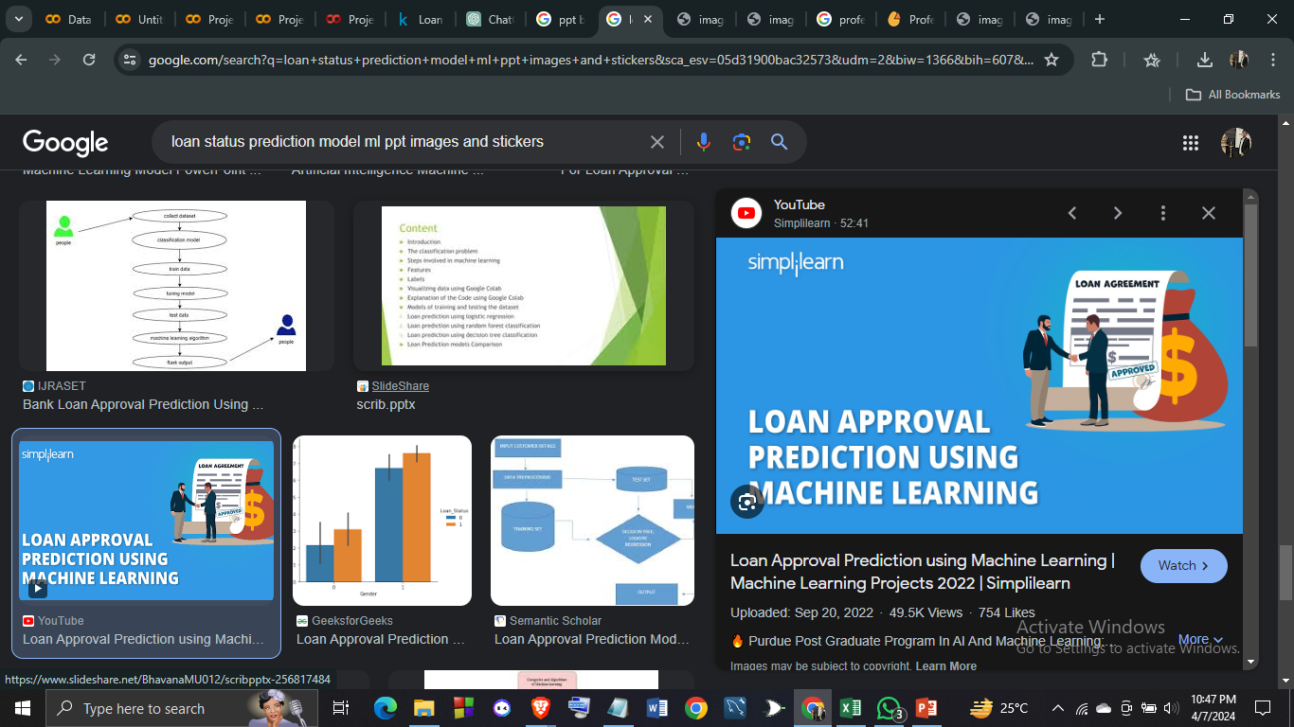
Introduction of project
Context and Significance:
In an era characterized by rapid technological advancements, the traditional processes governing loan approval often prove inefficient and prone to human bias. Recognizing the critical need for modernization within the financial sector, our project endeavors to revolutionize the loan assessment process through the application of machine learning.
Project Objectives:
At the heart of our project lies the ambition to develop a robust Loan Status Prediction Model capable of accurately evaluating loan applications based on a diverse array of applicant attributes. By harnessing the power of data-driven insights, we aim to enhance the efficiency, accuracy, and fairness of loan approval decisions.

Slide 6
Dataset Overview:
Leveraging a comprehensive dataset encompassing various demographic, financial, and credit-related features, our project seeks to uncover valuable patterns and trends that can inform the predictive modeling process. With a meticulous focus on data quality and relevance, we aim to derive actionable insights to fuel our predictive model's development.
Expected Impact:
Through the implementation of our Loan Status Prediction Model, we anticipate significant positive outcomes for both lenders and borrowers. By streamlining the loan approval process, reducing processing times, and mitigating the risk of default, our model has the potential to foster greater financial inclusivity and empowerment while bolstering the overall efficiency of lending institutions.

Slide 7
Current challenges FACED
Despite the critical role of loans in facilitating economic growth and personal financial stability, the traditional process of assessing loan applications is often plagued by inefficiencies and subjectivity. Manual evaluation methods, reliant on limited information and prone to human bias, contribute to prolonged processing times, suboptimal decision-making, and disparities in loan approval outcomes.
The overarching challenge lies in the need for a more objective, data-driven approach to loan assessment that harnesses the power of machine learning to analyze a diverse array of applicant attributes. By developing a robust Loan Status Prediction Model, capable of accurately predicting the likelihood of loan approval based on comprehensive applicant profiles, we aim to address these challenges and revolutionize the loan approval process.

Slide 8
Our project seeks to tackle this problem by leveraging advanced machine learning techniques to create a predictive model that enhances the efficiency, accuracy, and fairness of loan approval decisions. By identifying key predictors of loan status and automating the decision-making process, our model aims to streamline operations for lending institutions while promoting greater financial inclusivity and empowerment for borrowers.
The primary goal of our project is to develop a scalable and reliable Loan Status Prediction Model that can effectively handle large volumes of loan applications, optimize decision-making processes, and adapt to evolving lending trends. By achieving this goal, we aim to set a new standard for loan assessment practices and contribute to a more equitable and efficient financial ecosystem.

Slide 9


Project Feasibility Assessment
Hardware :The project's code does not impose any special hardware requirements. It should seamlessly execute on any modern computer equipped with a processor similar to i3/i5/i7 or above. As for memory, a minimum of 8.00 GB RAM is recommended to ensure smooth performance during data preprocessing, model training, and evaluation stages.
Software : The code uses standard Python libraries for data analysis and machine learning, which are widely supported and easy to install. Therefore, it is feasible in terms of software requirements.

Slide 10

Dataset
Name of the Dataset – Loan Status Prediction
Source – Kaggle (link 🔗 https://www.kaggle.com/datasets/bhavikjikadara/loan-status-prediction:)
For Unprocessed Data –
Number of features – 13
Number of Instances - 381

Slide 11
After data processing –
Number of features – 13
Number of Instances – 308
Output Variable Name – Class
Description: Classifies whether a loan application was approved or not based on various features used within the collected dataset.
Data Type: Categorical
Data Scale: Nominal Classes:
Class 1: Loan Approved
Class 0: Loan Not Approved
Data type of all Independent variables: Mixed
Data scale of all Independent variables: Ratio

Slide 12
Data pre-processing
To ensure the dataset's suitability for analysis, preprocessing techniques were applied to enhance its quality and relevance.
For effective training of machine learning models, attribute selection was performed to identify the most significant features or characteristics within the dataset. This process aids in reducing dimensionality and emphasizing the most informative variables.
Achieving Class Balance: Maintaining fairness in model training and evaluation requires a balanced representation of samples across diverse classes, such as individuals with Parkinson's disease and healthy controls. To achieve this balance, various strategies like oversampling, undersampling, or synthetic data generation may be employed.

Slide 13
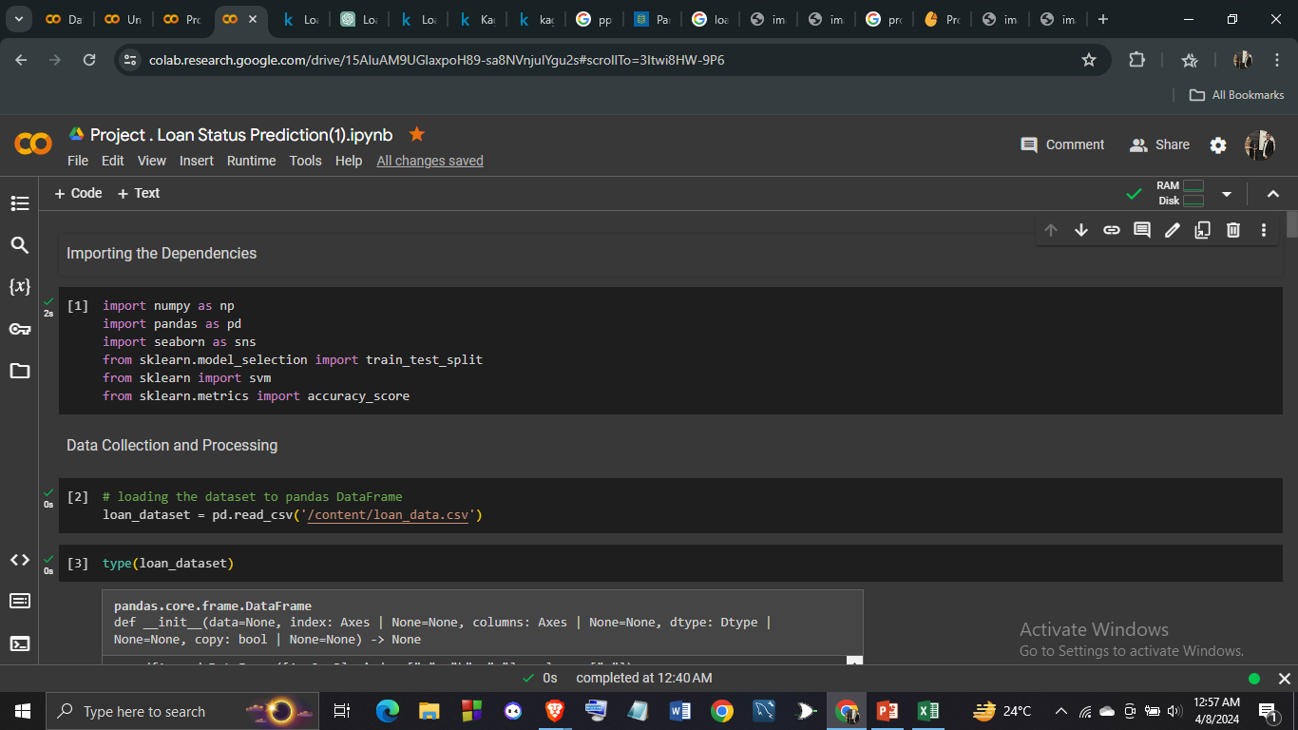
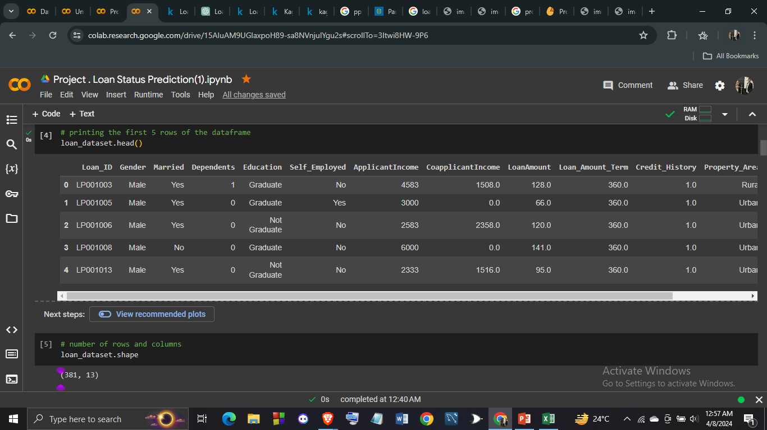
Before data pre-processing :

Slide 14
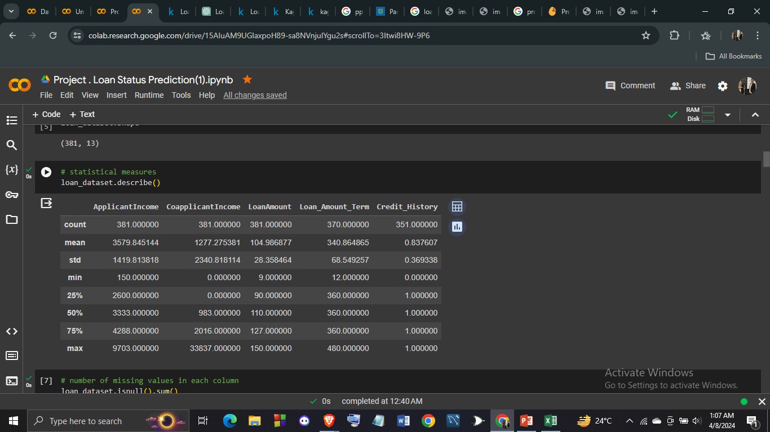
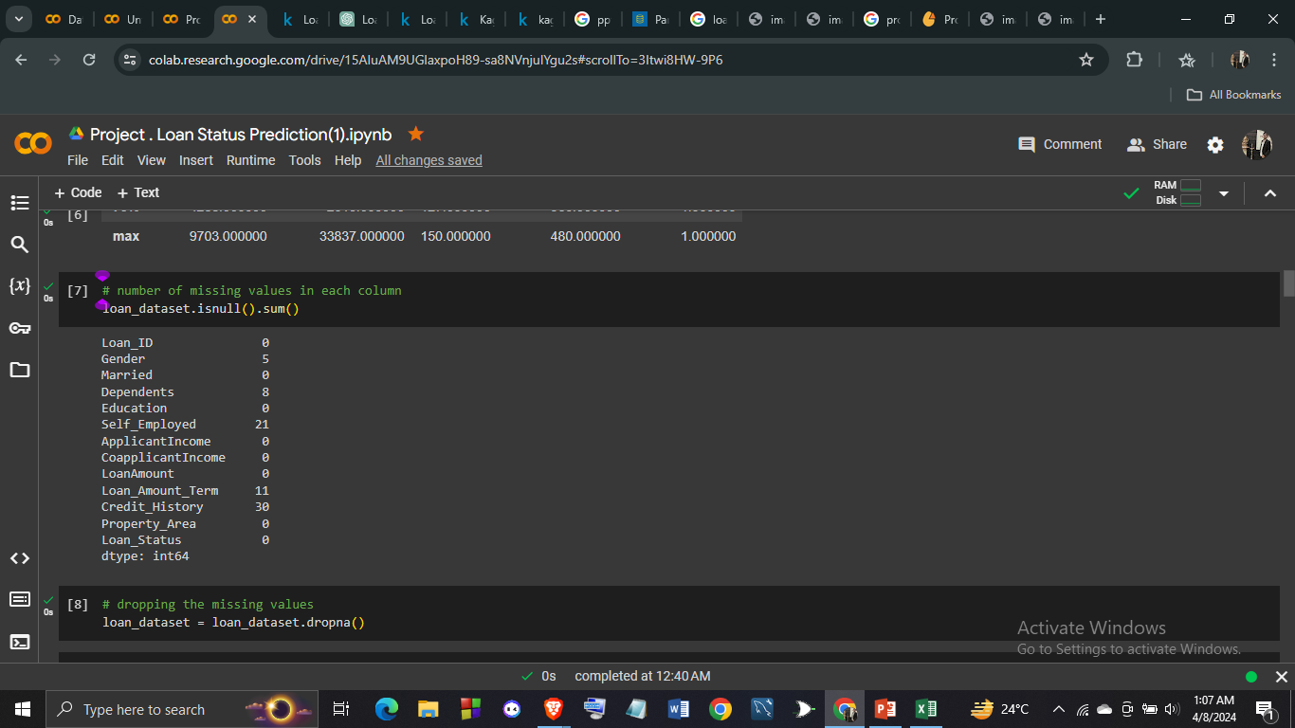
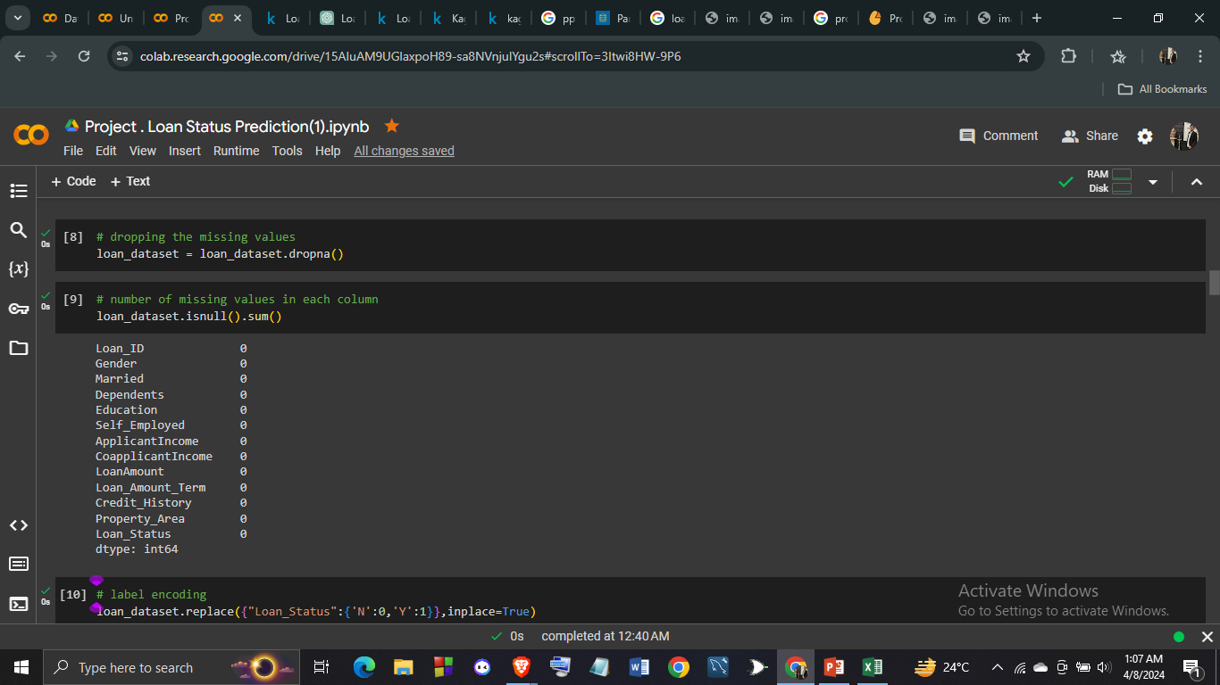
#Missing values
Dropping missing values- By removing rows or columns with missing data, you ensure that your dataset is complete and consistent, which can lead to more accurate results and interpretations. Additionally, dropping missing values can simplify data preprocessing and modeling processes, as you don't have to deal with imputation techniques or potential biases introduced by incomplete data. Overall, dropping missing values can streamline your workflow and improve the quality of your analysis.

Slide 15
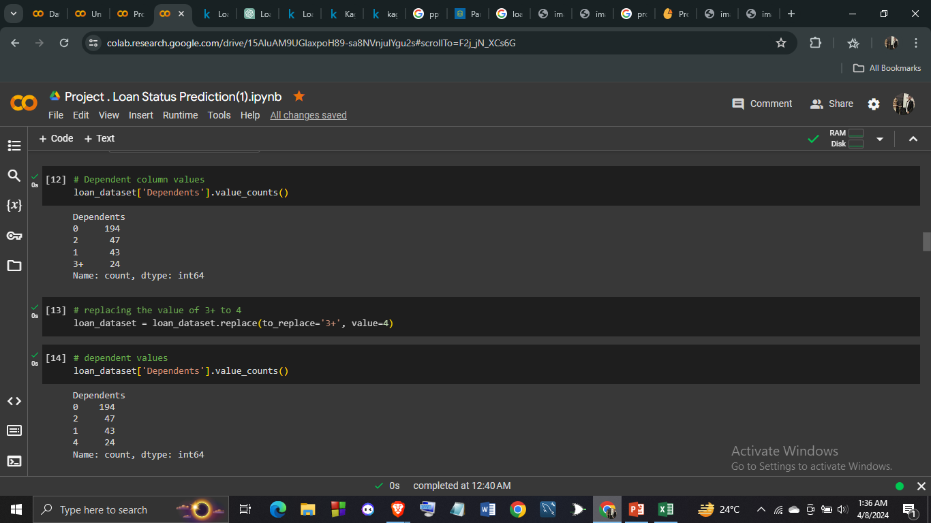
Now , changing number of dependents of 3+ to 4

Slide 16
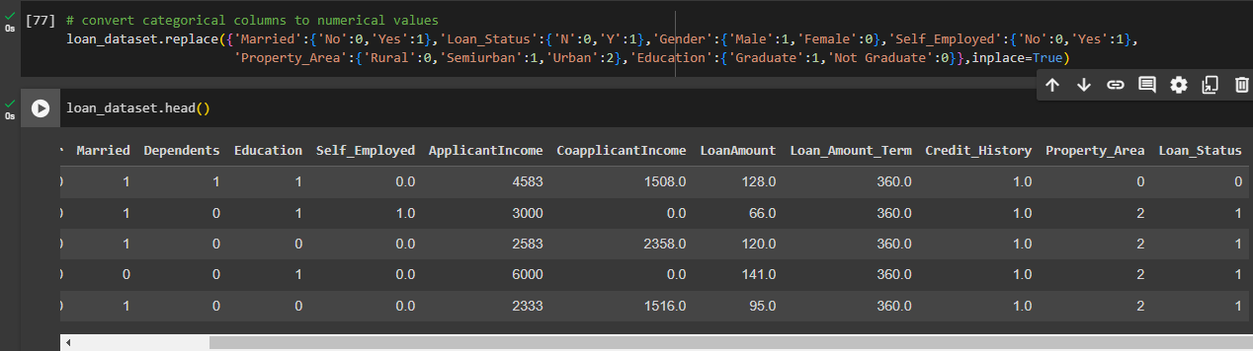
Now , Converting all Categorical values into Numerical values - Many machine learning algorithms, such as logistic regression or support vector machines, require numerical input data. By converting categorical values into numerical ones, you enable these algorithms to understand and interpret the data, which can lead to better performance and more accurate predictions. Additionally, numerical encoding of categorical variables can help to uncover relationships and patterns in the data that may not be apparent when using categorical values directly.

Slide 17
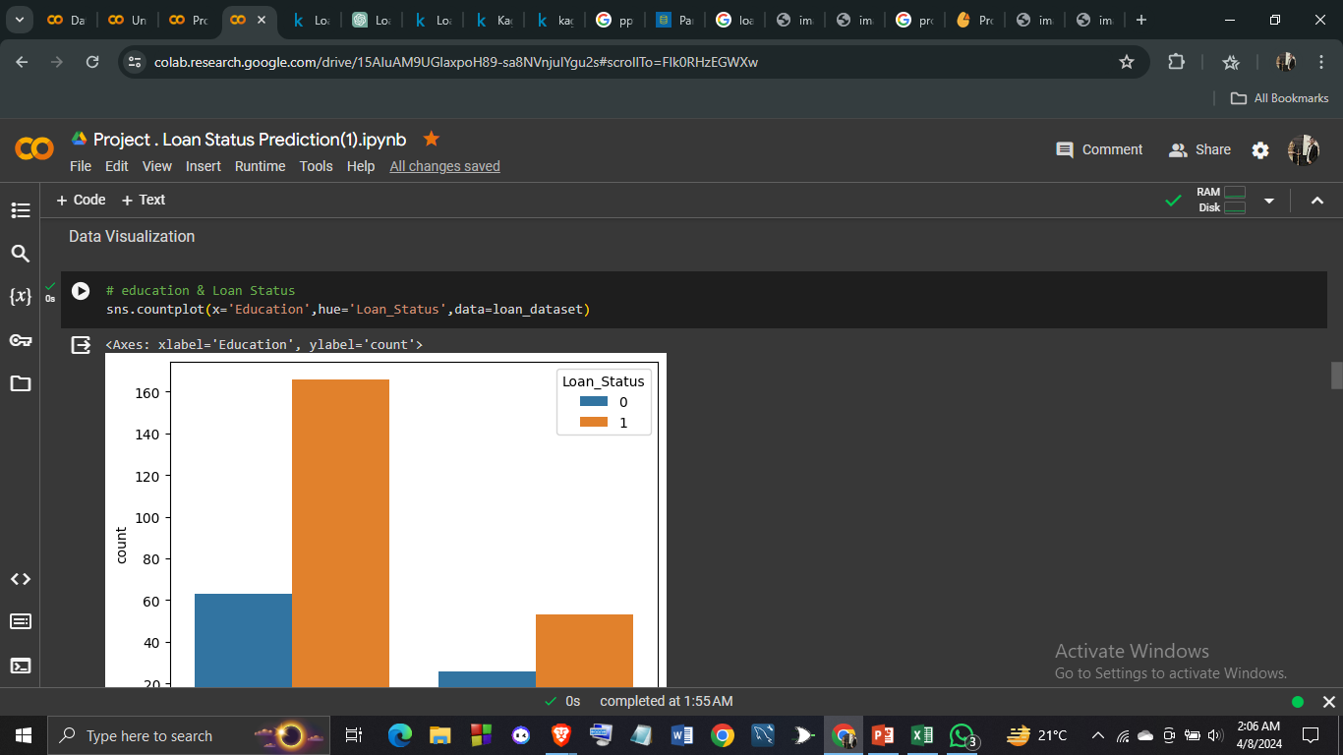
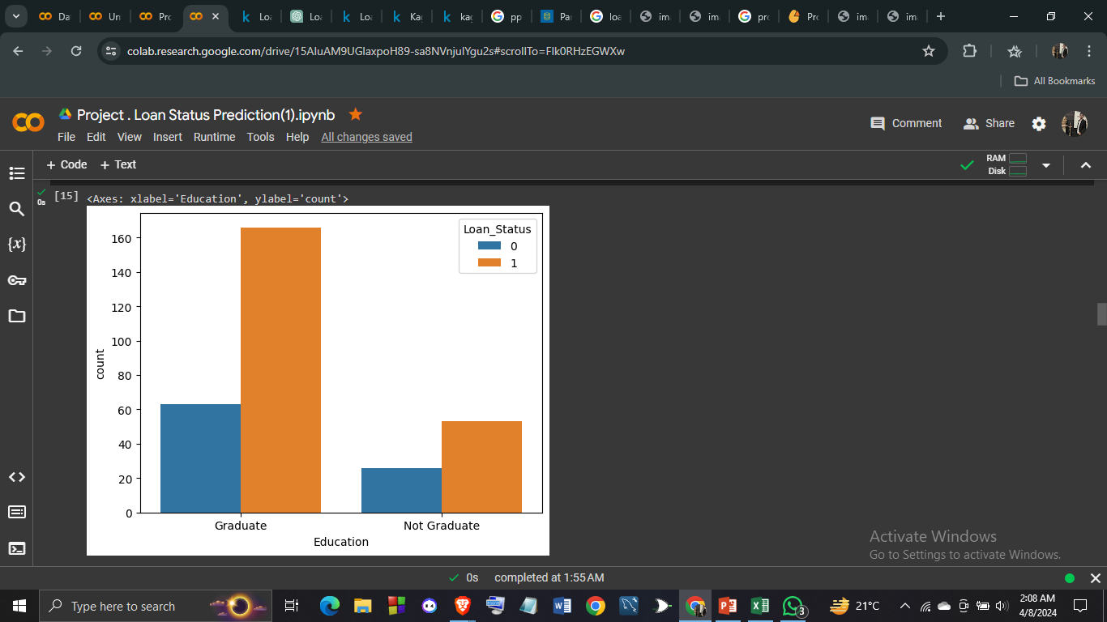
DATA VISUALIZATION:- 1.

Slide 18
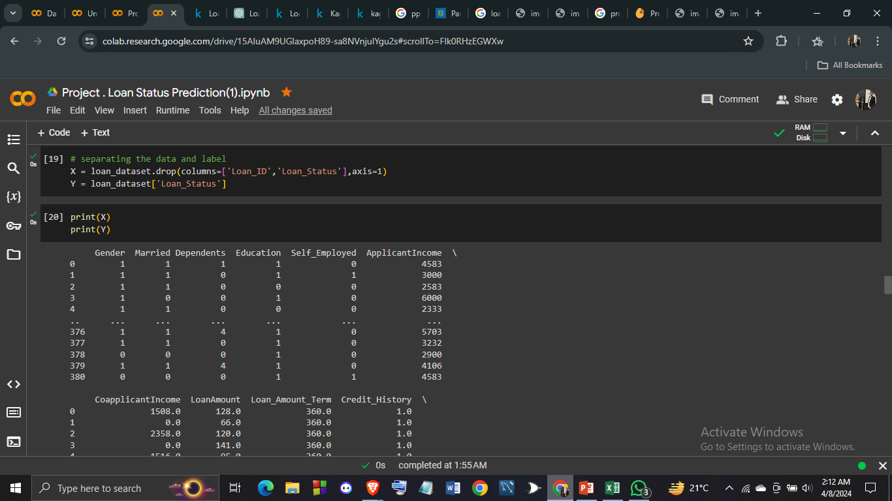
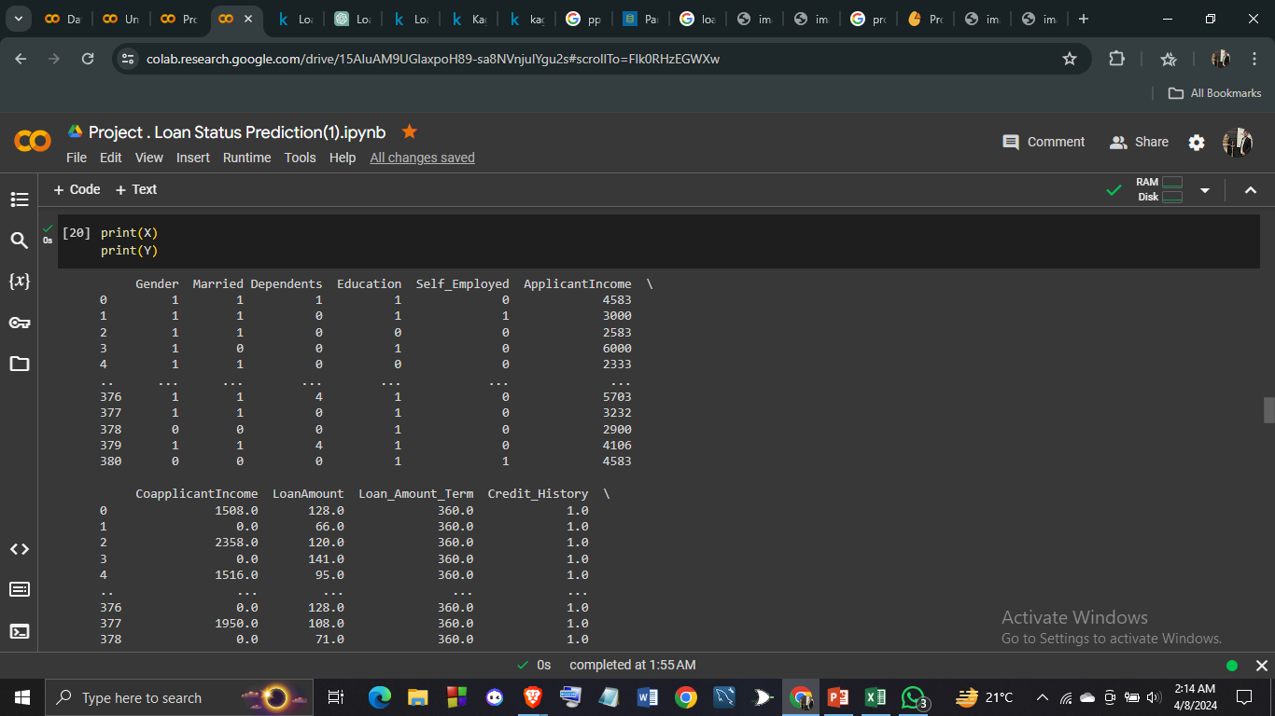
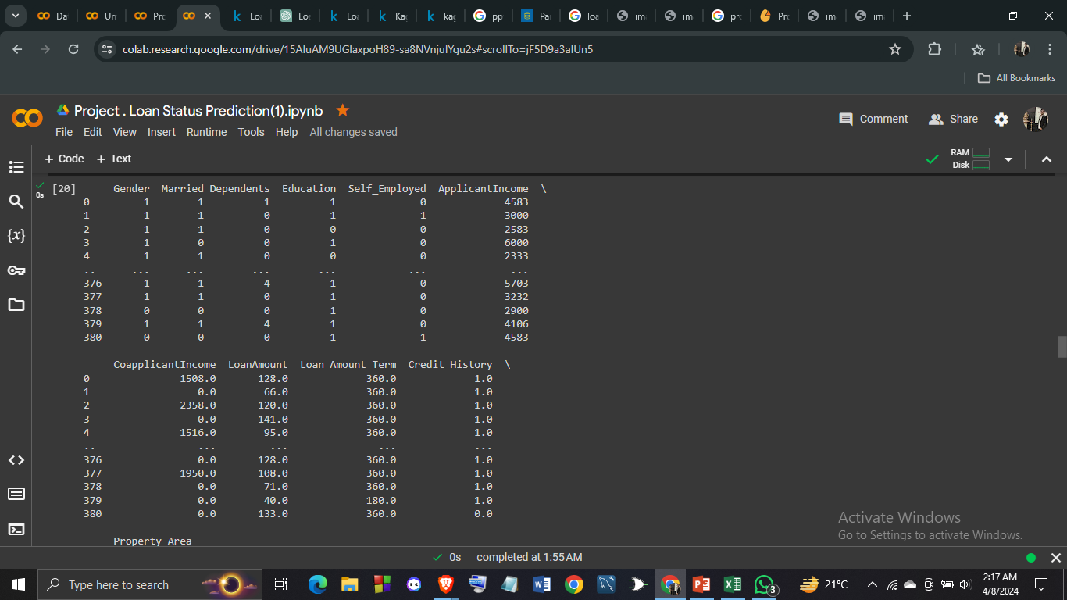
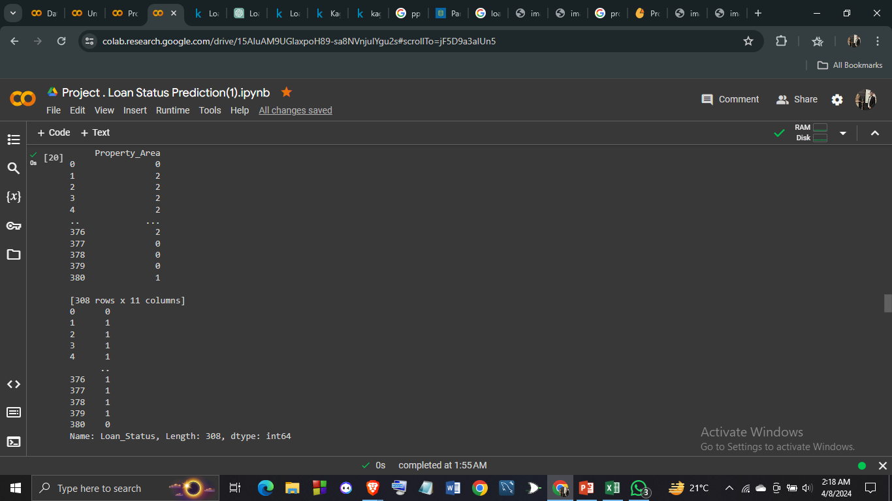
Separating Data and Lablel and printing X and Y-

Slide 19
Train-Test Split (9:1): By dividing the dataset into testing and training sets in an 90:10 ratio, most of the data is used to assess the model's performance, while the remaining portion is used to train the model. This aids in evaluating the model's ability to generalize on untested data.
The train_test_split function from the sklearn.model_selection module is an essential tool in machine learning workflows for partitioning datasets into training and testing subsets. By splitting the data into separate sets, it enables practitioners to train machine learning models on one portion of the dataset and evaluate their performance on another, unseen portion.

Slide 20
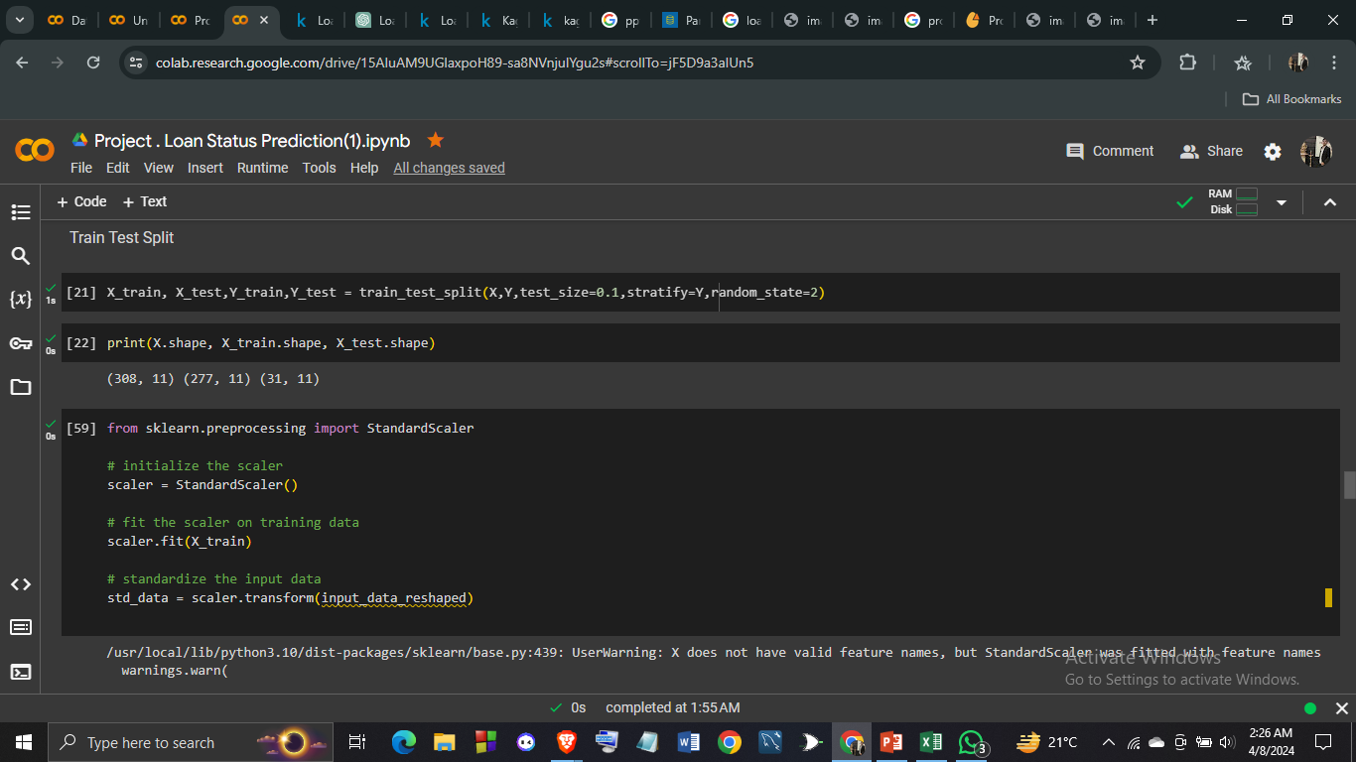
Here, test_size=0.1 specifies that 10% of the data will be allocated to the testing set (X_test), while the remaining 90% will be used for training (X_train). The random_state=2 parameter ensures reproducibility by fixing the random seed, thus providing consistent results across different runs. Here we also import standard scaler

Slide 21
We import StandardScaler from the scikit-learn library (sklearn) in order to scale our feature variables. StandardScaler is used to standardize features by removing the mean and scaling them to unit variance.
The main reasons for using StandardScaler are:
Normalization of Features: StandardScaler helps in bringing all features to the same scale, which can prevent certain features from dominating the model's learning process due to their larger scales. This is particularly important for algorithms that are sensitive to feature scales, such as support vector machines (SVM) or k-nearest neighbors (KNN).
Improvement of Model Performance: Standardizing features can lead to improved model performance, convergence, and stability, especially for algorithms that involve gradient descent optimization.
Assumption of Many Machine Learning Models: Many machine learning models assume that the features are normally distributed with zero mean and unit variance. StandardScaler helps in meeting these assumptions, thereby enhancing the performance of such models.
Interpretability and Understanding: Standardizing features can make the coefficients or importance of features more interpretable, as they are on the same scale. This can aid in understanding the relative importance of different features in the model.
Overall, importing StandardScaler allows us to preprocess our data effectively and prepare it for training machine learning models, ultimately leading to better model performance and interpretability.

Slide 22
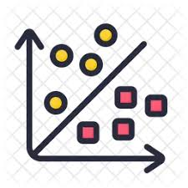

Models used:-
Support Vector Machine(SVM)
Logistic Regression

Slide 23
Performance Measures and result
Accuracy: Proportion of correctly classified instances out of total instances. Higher accuracy indicates better performance.
Precision: Proportion of correctly predicted positive cases out of all predicted positive cases. Emphasizes model's exactness.
Recall (Sensitivity): Proportion of correctly predicted positive cases out of all actual positive cases. Highlights model's ability to capture positive cases.

Slide 24
Performance Measures and result
Accuracy: Proportion of correctly classified instances out of total instances. Higher accuracy indicates better performance.
Precision: Proportion of correctly predicted positive cases out of all predicted positive cases. Emphasizes model's exactness.
Recall (Sensitivity): Proportion of correctly predicted positive cases out of all actual positive cases. Highlights model's ability to capture positive cases.

Slide 25
F1 Score: Harmonic mean of precision and recall. Provides balanced measure of accuracy, suitable for imbalanced datasets.
Geometric Mean (G-Mean): Measures geometric mean of sensitivity and specificity. Useful for assessing model effectiveness across classes, especially in imbalanced datasets.

Slide 26
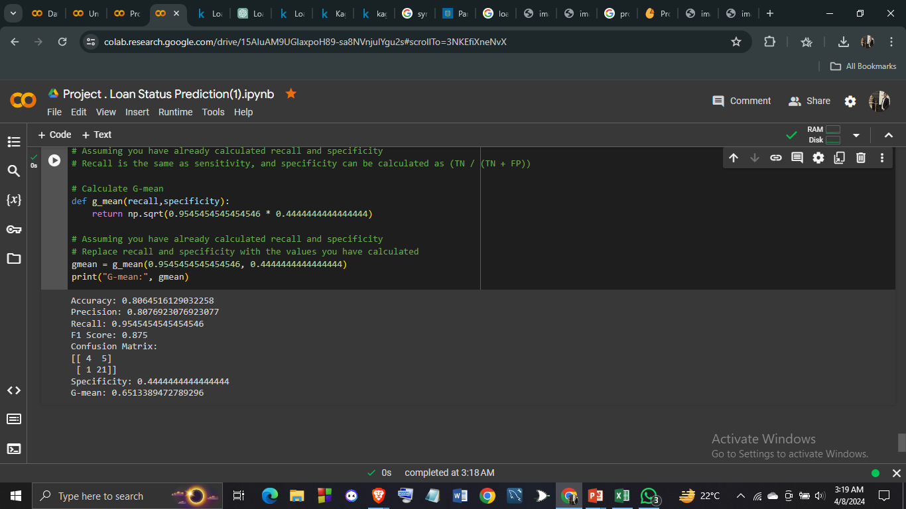
Performance measures for SUPPORT VECTOR MACHINE(SVM):-
Support Vector Machine:-

Slide 27
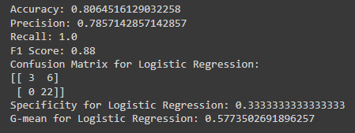
Performance measures for logistic regression:-

Slide 28
Result
Support Vector Machine(SVM) outperforms Logistic Regression based on the provided statistics due to several factors:
Accuracy: Support Vector Machine(SVM) and Logistic Regression have same accuracy of (0.8065), indicating better overall classification performance.
Precision: With a slightly higher precision (0.8077 vs. 0.7857), Support Vector Machine(SVM) makes fewer false positive predictions than Logistic Regression.

Slide 29
F1 Score: Logistic Regression achieves a higher F1 Score (0.88 vs. 0.875), indicating a better balance between precision and recall compared to Support Vector Machine(SVM) .
Geometric Mean Score: Support Vector Machine(SVM) has higher geometric mean score (0.651 vs. 0.577) suggests better overall performance, especially in handling imbalanced datasets.
These metrics collectively indicate that Support Vector Machine(SVM) is more effective for this classification task, offering superior accuracy and balance between precision and recall compared to Logistic Regression.

Slide 30
Limitations
Sensitivity to Parameters: SVM performance heavily depends on the choice of parameters such as the kernel type, kernel parameters, and regularization parameter. Selecting the optimal parameters can be challenging and may require extensive tuning.
Memory Intensive: SVMs can become memory intensive, especially when dealing with large datasets. The computational complexity of SVM training grows quadratically with the number of samples, making it impractical for very large datasets.

Slide 31
Limited Interpretability: While SVMs are effective at making predictions, the models they produce are often difficult to interpret. Unlike decision trees or logistic regression, SVMs do not provide easily interpretable insights into the relationships between features and the target variable.
Sensitivity to Noise: SVMs are sensitive to noisy data, outliers, and overlapping classes. Noisy data can significantly affect the placement of the decision boundary and reduce classifier performance.
Binary Classification: SVMs are inherently binary classifiers and are not directly applicable to multi-class classification problems. While there are techniques such as one-vs-one or one-vs-rest to extend SVMs to multi-class classification, they may not always perform optimally.

Slide 32
Computationally Expensive: SVM training can be computationally expensive, especially for large datasets or datasets with high-dimensional feature spaces. This can make SVMs impractical for real-time or online learning scenarios.
Difficulty with Large Feature Spaces: SVMs may not perform well when the number of features is much larger than the number of samples. In high-dimensional feature spaces, SVMs may suffer from the "curse of dimensionality," leading to overfitting or increased computational complexity.

Slide 33
Conclusion
Similar Accuracy: Both SVM and Logistic Regression models achieved similar accuracy scores on the test data (around 80.6%). This indicates that both models are capable of making accurate predictions on unseen data.
Different Recall and F1 Score: While SVM achieved a higher precision than Logistic Regression, it had lower recall and F1 scores. This suggests that SVM may be better at correctly identifying the positive class (higher precision), but it may miss some positive instances, leading to lower recall and F1 score.
Interpretability: Logistic Regression models are more interpretable compared to SVM. They provide coefficients that indicate the strength and direction of the relationship between features and the target variable. This interpretability can be valuable in understanding the factors influencing loan approval decisions.

Slide 34
Sensitivity to Imbalance: Logistic Regression may be more sensitive to class imbalance compared to SVM. If the dataset has imbalanced classes, Logistic Regression may struggle to correctly predict the minority class, resulting in lower recall and F1 scores.
Computational Complexity: SVMs tend to be more computationally intensive, especially for large datasets or datasets with high-dimensional feature spaces. Logistic Regression, being a simpler model, may be more efficient to train and deploy in certain scenarios.

Slide 35
references
1. Google Colab: Colaboratory.
2. Scikit-learn: Machine Learning in Python.
3. Coursera: "Machine Learning" course by Andrew Ng.
4. Coursera: “Machine Learning” course by Siddarthan.
5. Assembly AI: Machine Learning Course.

Slide 36
THANK YOU

